Slide 1

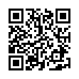
Amateur Radio License Exams on an Amazon Fire HD Tablet
Herb Weiner, AA7HW
herbw@wiskit.com
November 19, 2022
https://aa7hw.org/exams-on-tablet.pdf
https://creativecommons.org/licenses/by-sa/4.0

Slide 2
Please silence your cell phones.
You may not leave the room during the exam. If you need to use the restroom, please do so prior to the start of the exam.
Please place personal belongings under your chair or table during the test.
Please remain quiet during the exam. Please be courteous toward others who may still be testing after you complete your exam.
Please remain seated. If you need assistance, please raise your hand.

Slide 3
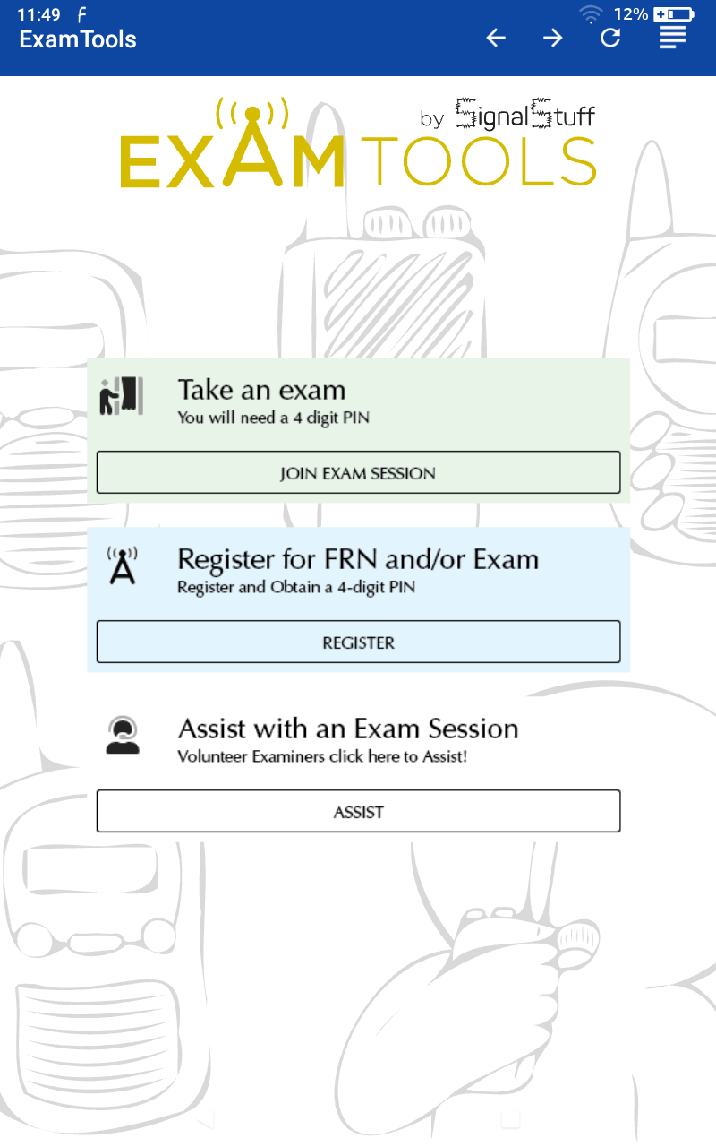
Initial Tablet Screen
This is the screen you will see when you receive your tablet.
Click on the light green JOIN EXAM SESSION to begin.

Slide 4
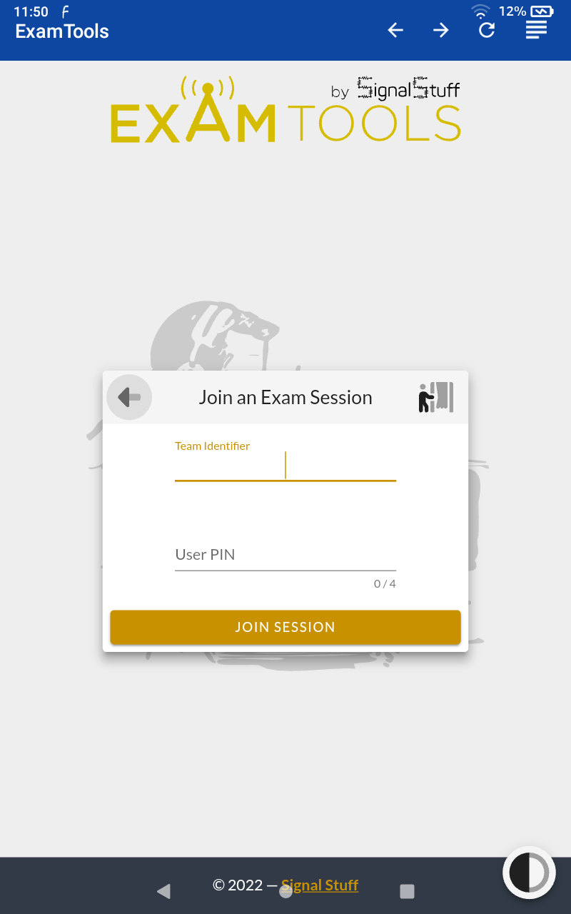
Fill in Requested Items
The Team Identifier is AA7HW.
On the second line, enter the 4-digit User PIN that you received when you registered.
Click JOIN SESSION.

Slide 5
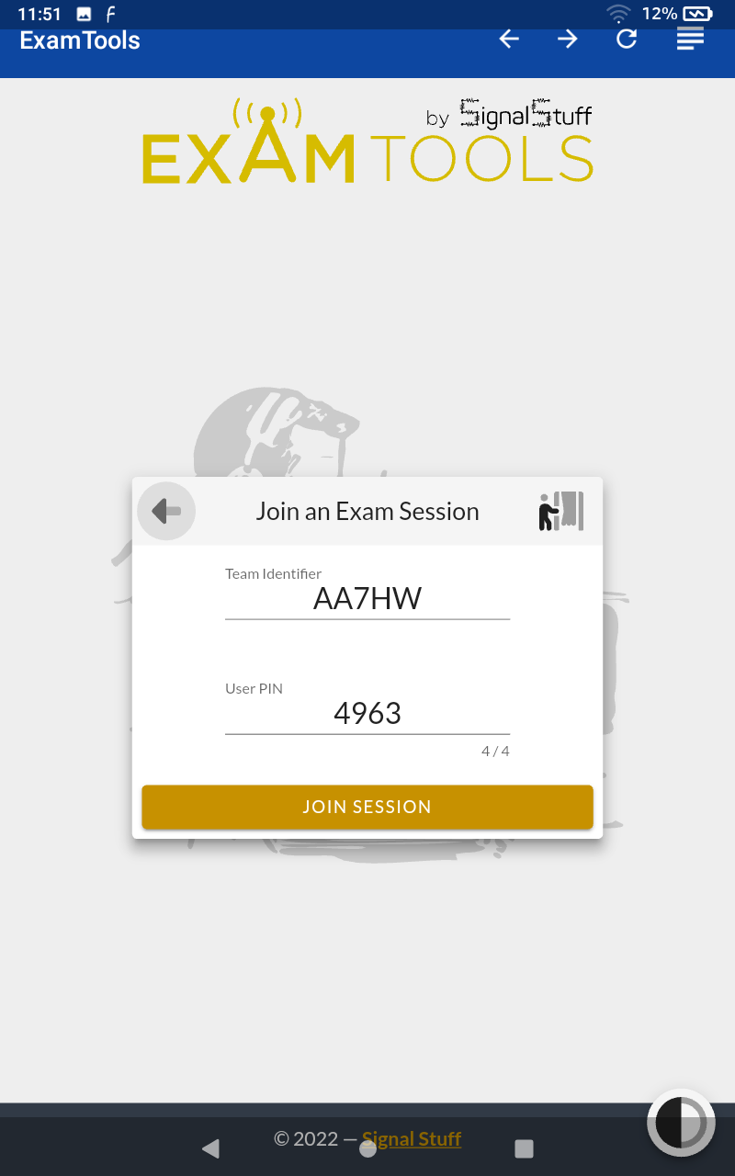
Join Exam Session
This candidate’s User PIN is 4963.
The candidate is about to click JOIN SESSION.

Slide 6
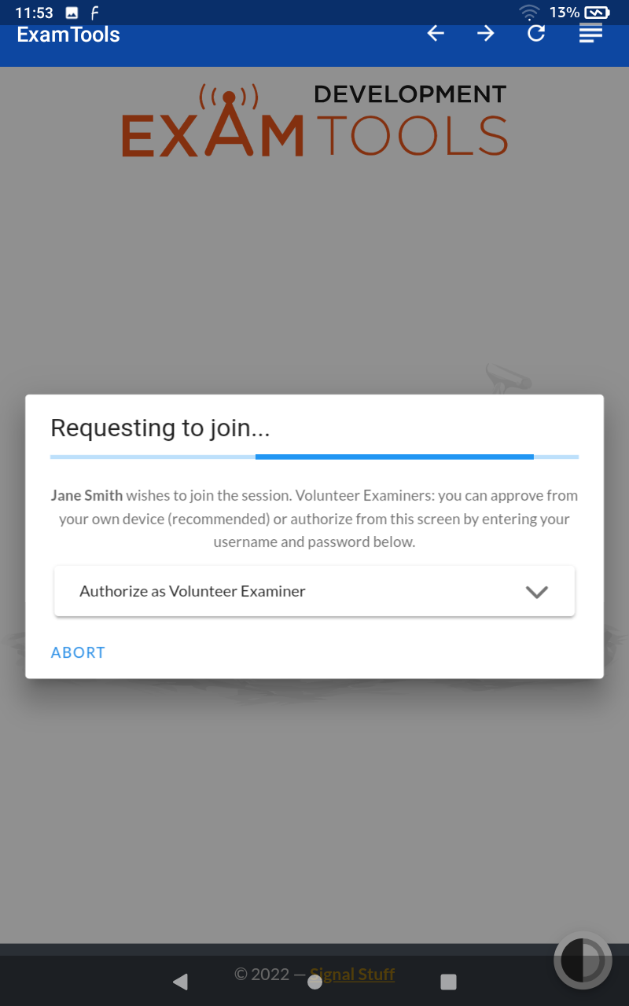
Requesting to Join
After you click JOIN SESSION, one of the Volunteer Examiners must authorize your request.
Please be patient.

Slide 7
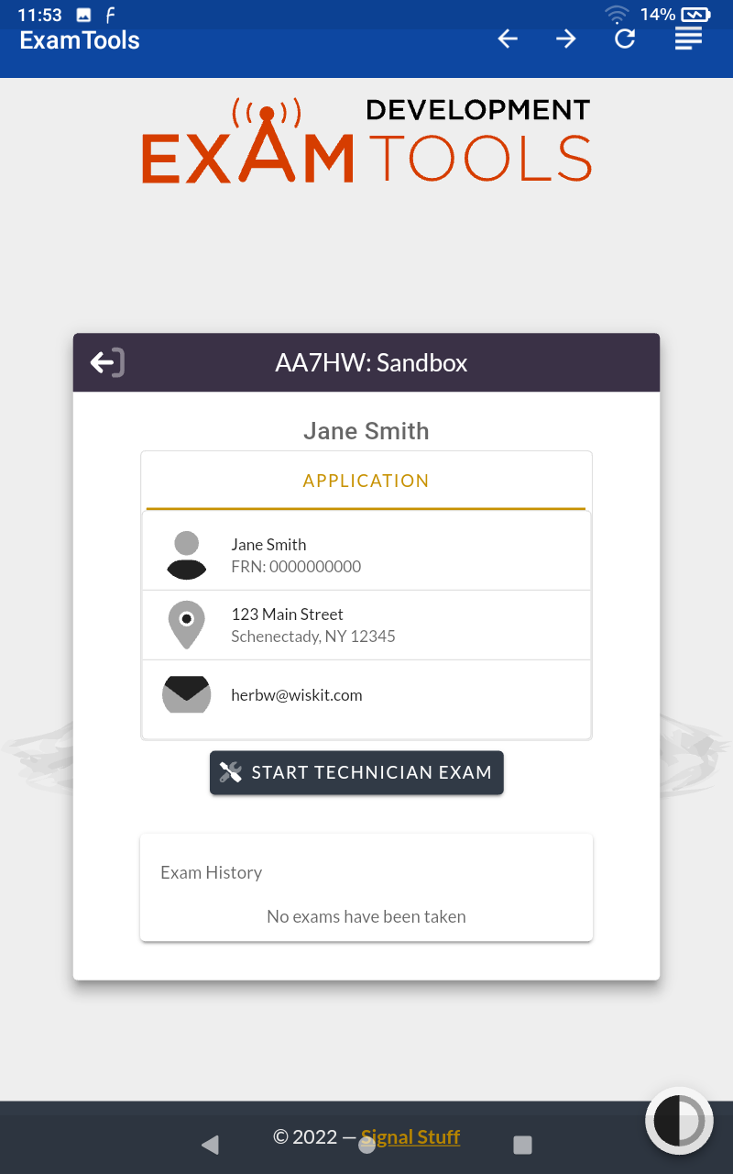
Review your Information
After your request to join has been approved, you will see a summary of the information you supplied when you registered.
Please review this information, then click START EXAM.

Slide 8
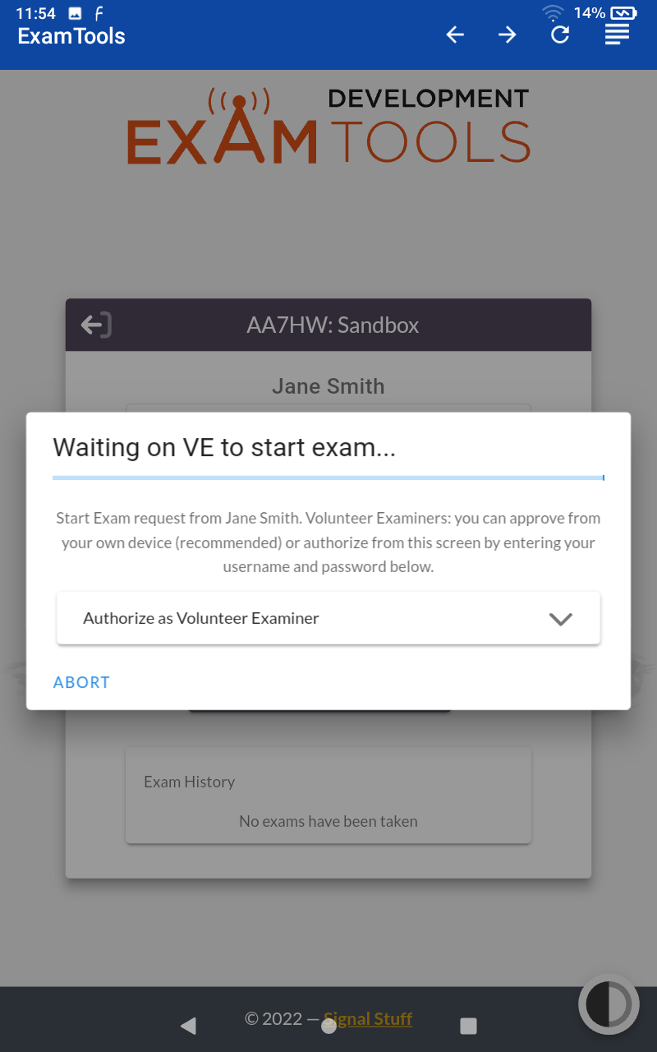
Waiting on VE
After you click START EXAM, one of the Volunteer Examiners must authorize your request.
Please be patient.

Slide 9
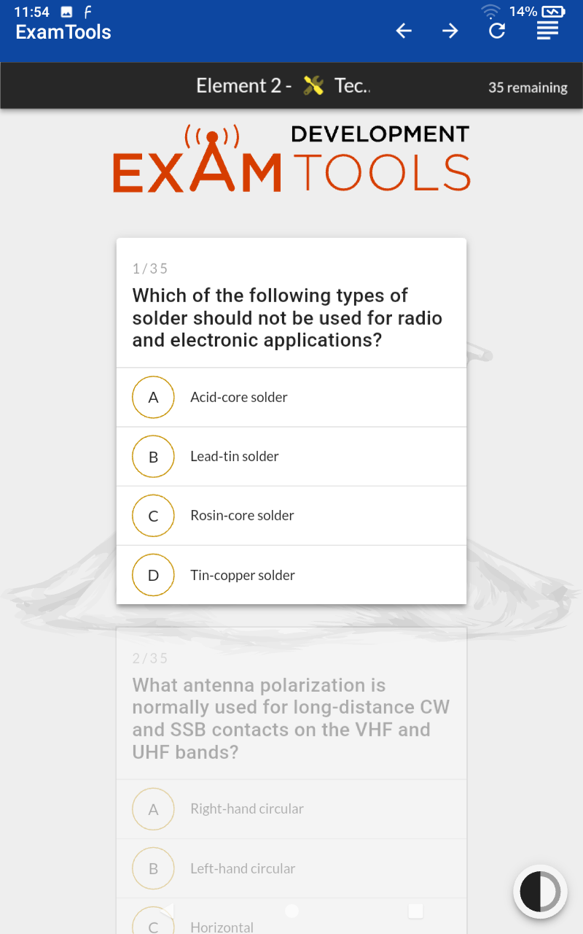
Ready to Begin Exam
Touch only once to select an answer. Touch a different answer to change your answer. Tablet may take a few seconds to respond.
You need 26 / 35 to pass the Technician or General exam, or 37 / 50 to pass the Amateur Extra exam.

Slide 10
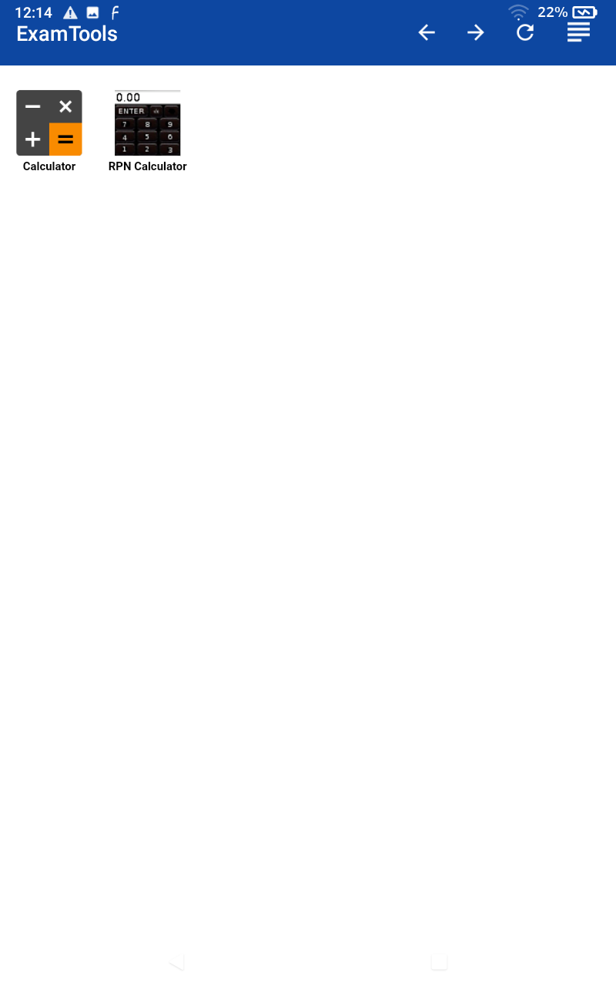
Two Calculators
Touch the four lines in the upper right corner to access either of the calculators.
The calculator on the left is a standard calculator.
The calculator on the right is an RPN (HP-style) calculator.
Click a calculator, or click the left arrow to return to your exam.

Slide 11
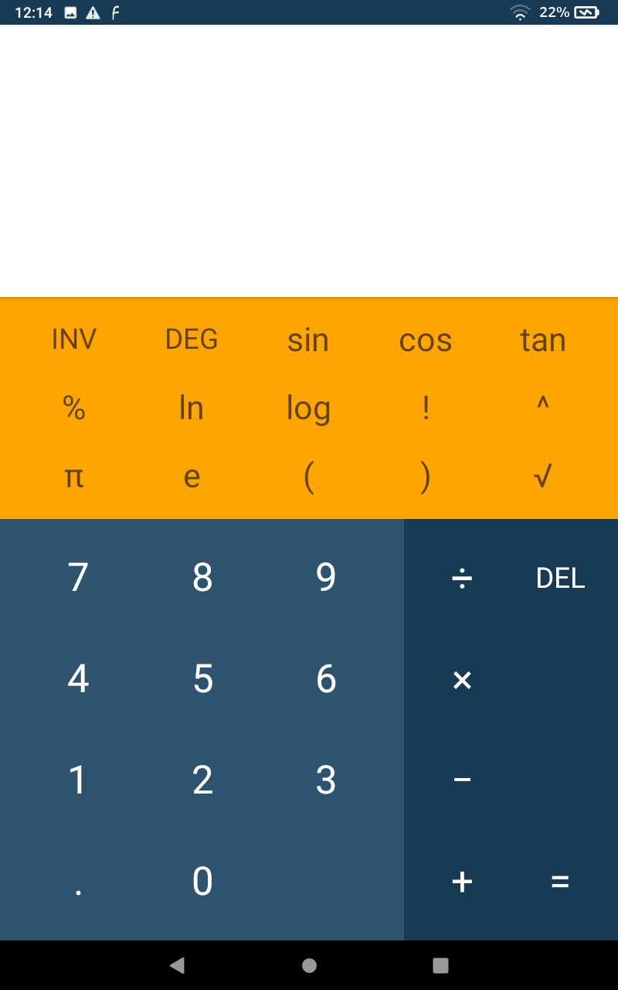
Standard Calculator
Here is the standard calculator.
Click the back triangle in the bottom left when you are done with the calculator.

Slide 12
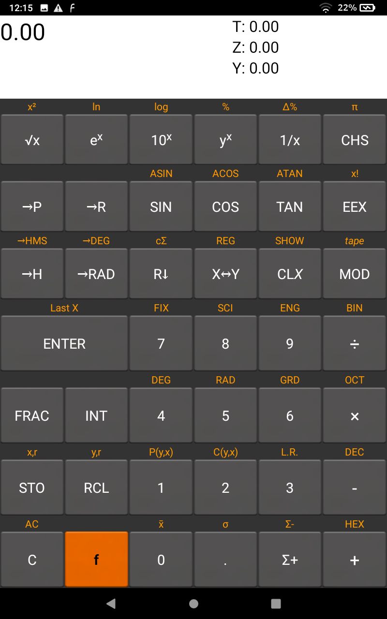
RPN Calculator
Here is the RPN (HP-style) calculator.
Click the back triangle in the bottom left when you are done with the calculator.

Slide 13
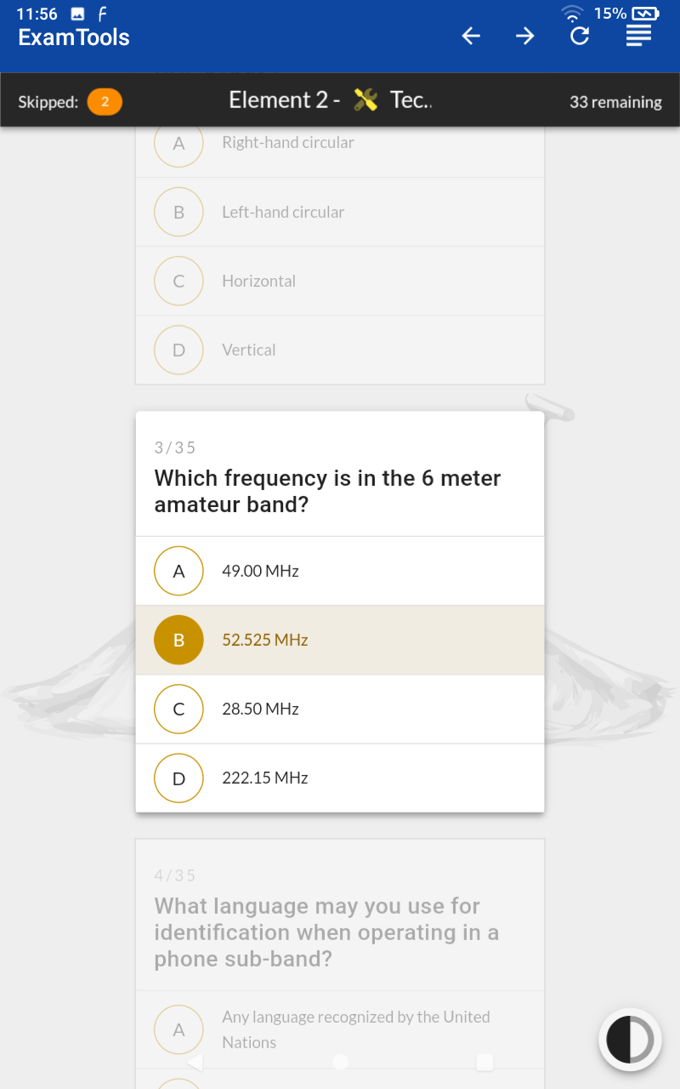
Taking the Exam
The candidate has selected answer B for question 3.
The orange bubble in the top left of the black bar indicates that the candidate has skipped question 2.
The number in the top right of the black bar indicates the number of questions remaining.

Slide 14
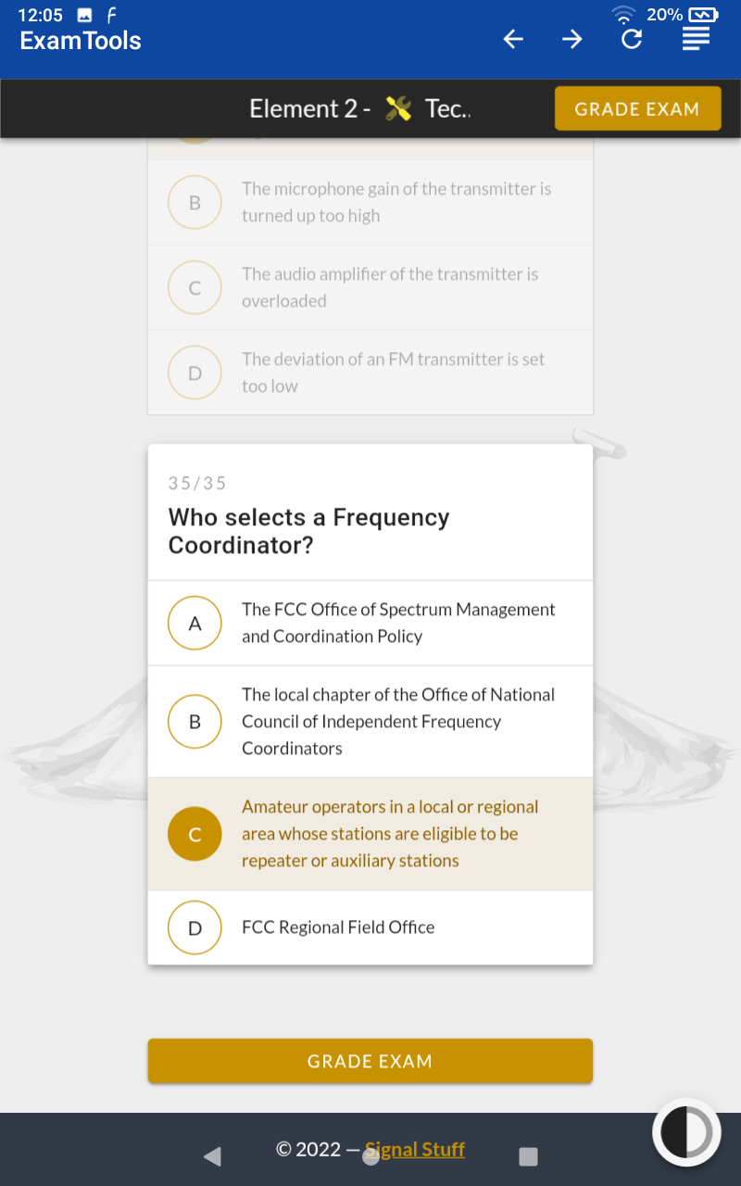
Ready to Grade Exam
When all questions have been answered, the number of questions remaining changes to a GRADE EXAM button.
A second GRADE EXAM appears at the bottom of the exam.
You are free to review your answers prior to clicking GRADE EXAM.

Slide 15
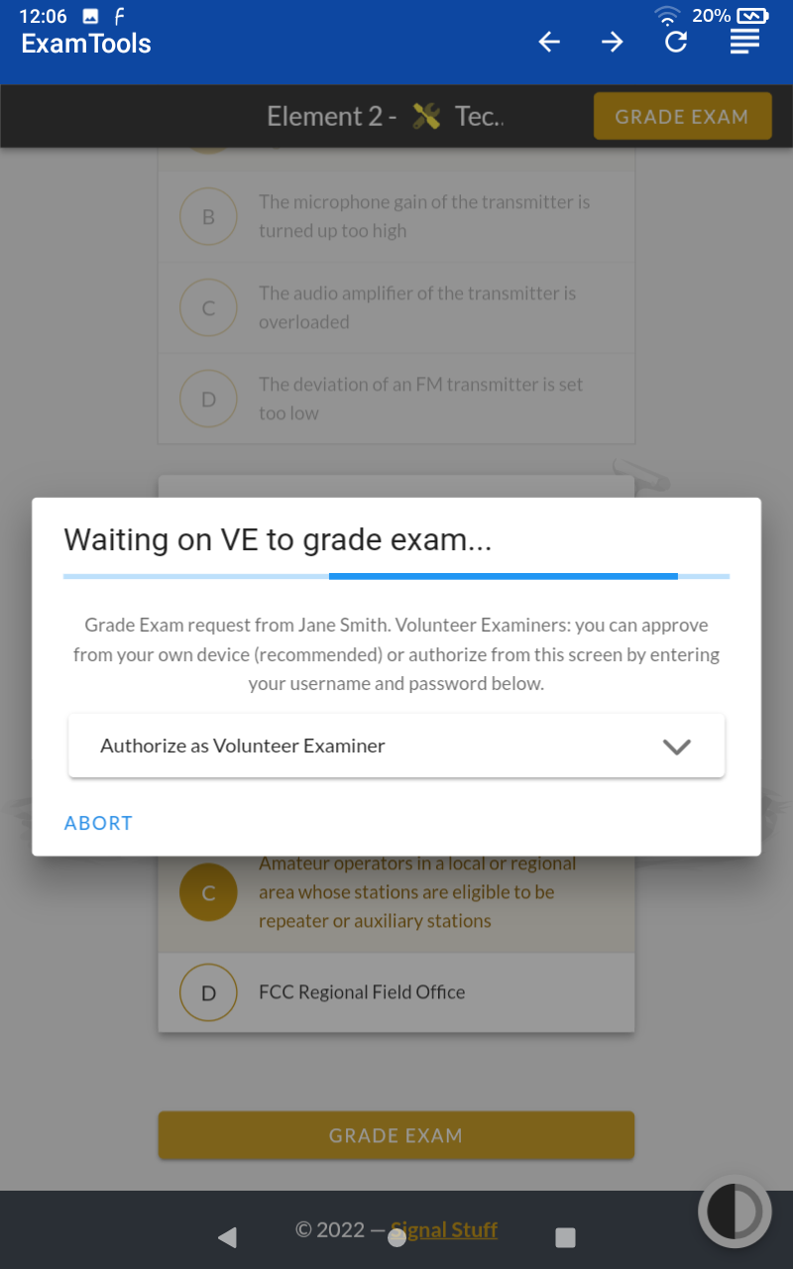
Waiting on VE
After you click GRADE EXAM, one of the Volunteer Examiners must authorize your request.
Please raise your hand, so a Volunteer Examiner can come over to assist you.

Slide 16
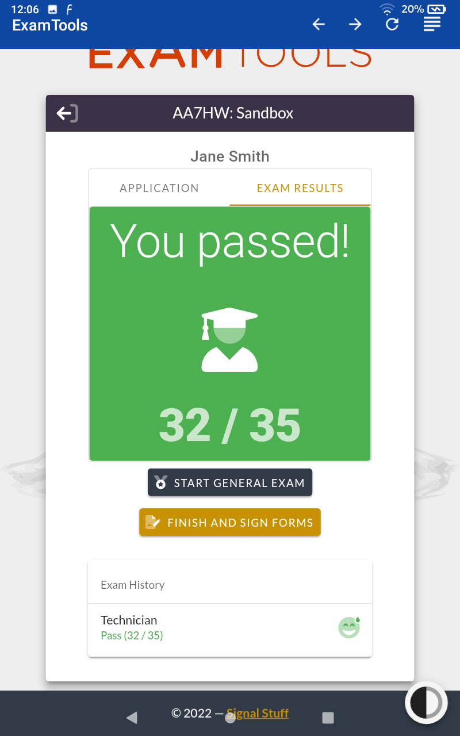
You Passed!
Your score is presented in Green.
You are not permitted to see which questions you missed.
If you have studied, you may take the next exam. (If you have not studied, you would be unlikely to pass.)
If you are finished, please click FINISH AND SIGN FORMS.

Slide 17
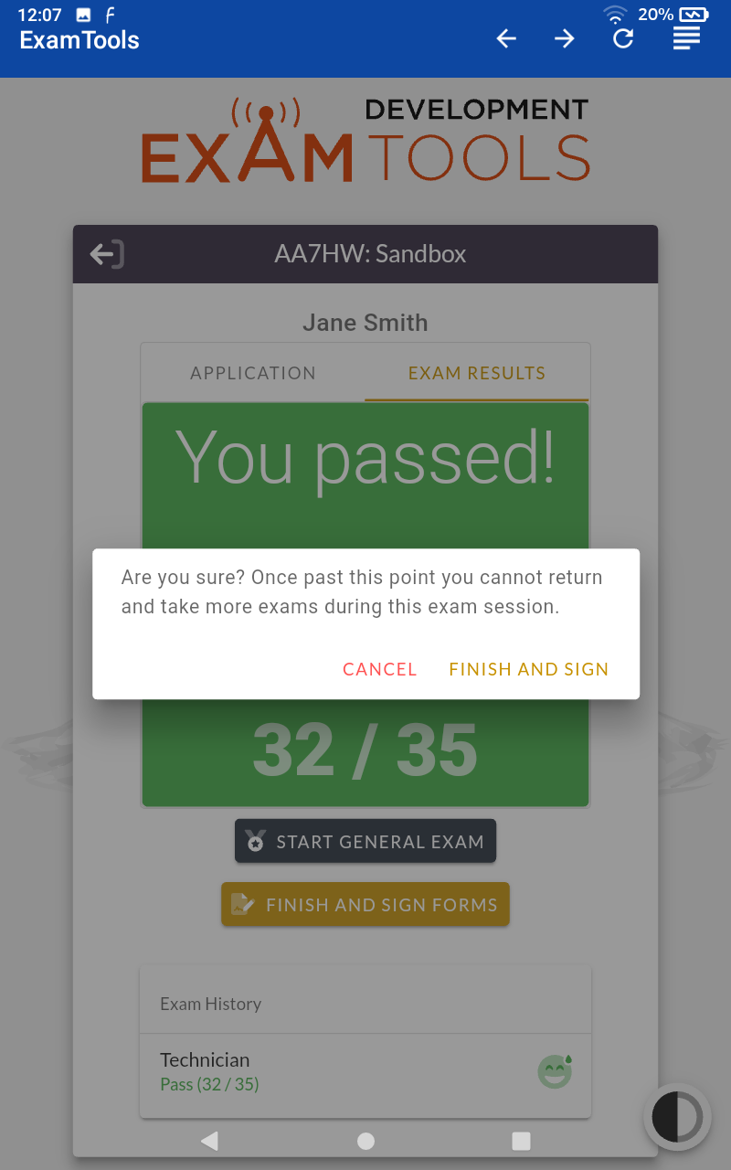
Confirm
Press FINISH AND SIGN again to confirm that you really are finished.
If you have an expired Amateur Radio license, be sure to inform the Volunteer Examiner. You may be eligible for element credit.

Slide 18
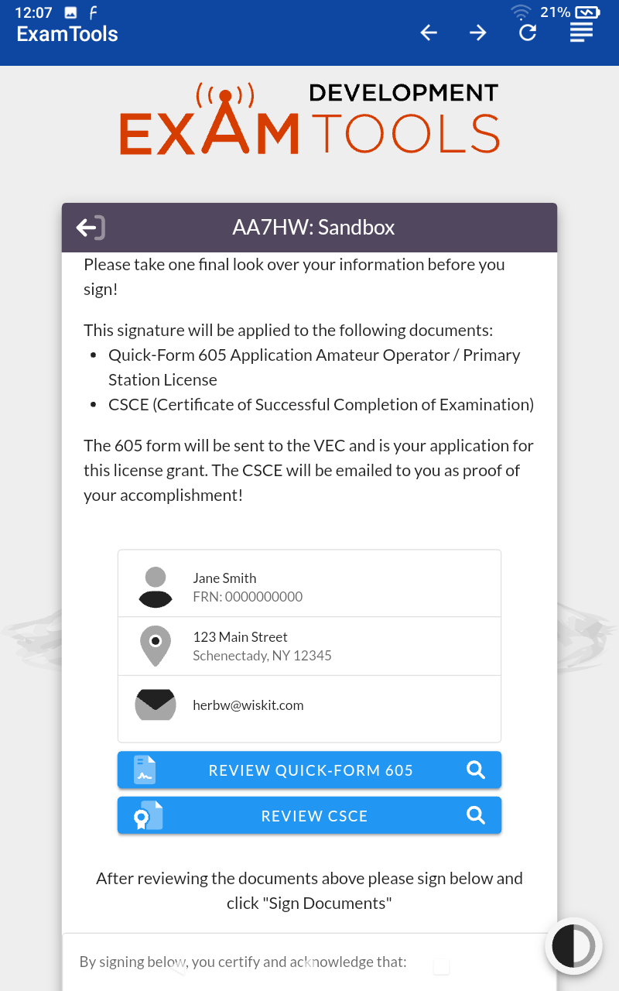
Ready to Review Forms
There are two documents that you will be signing electronically.
Click each of the two blue buttons to review them prior to signing.

Slide 19
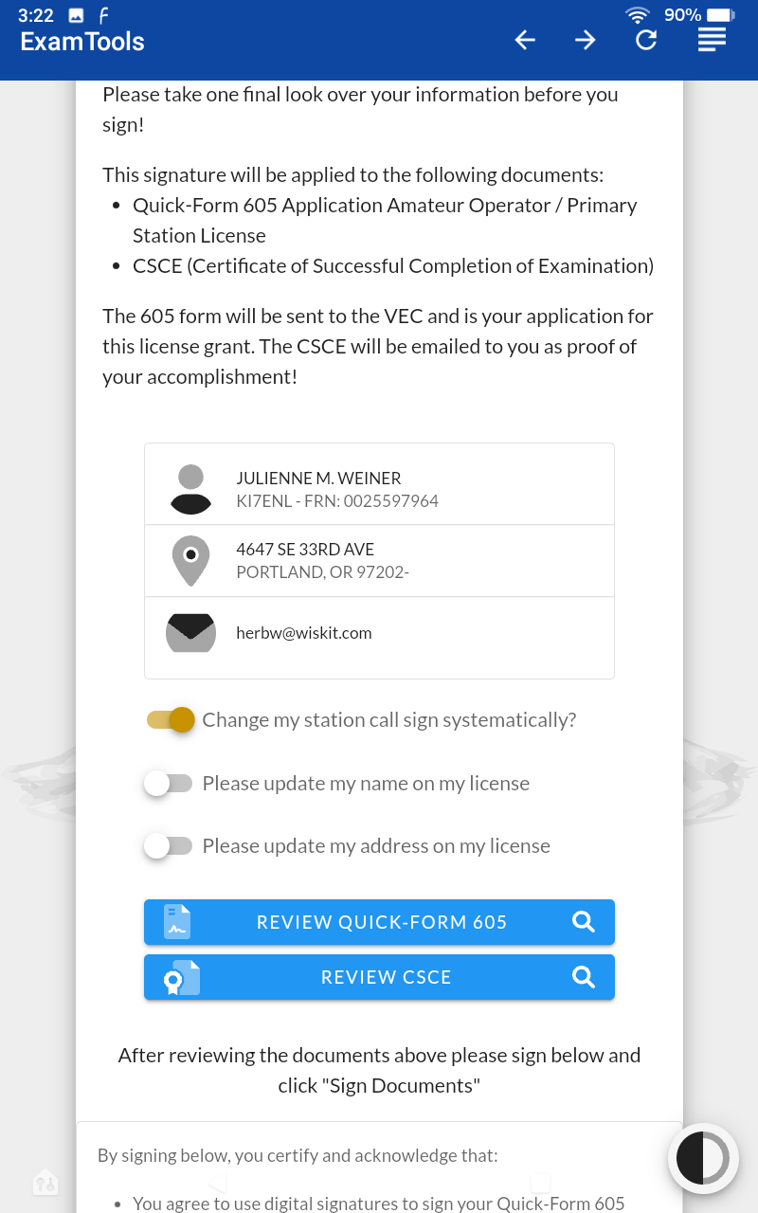
Change Call Sign
If you have earned an upgrade to an Amateur Extra license, you may optionally change your call sign systematically.
If you do, you would give up your current call sign and receive a new 2x2 call sign beginning with the letter A.

Slide 20
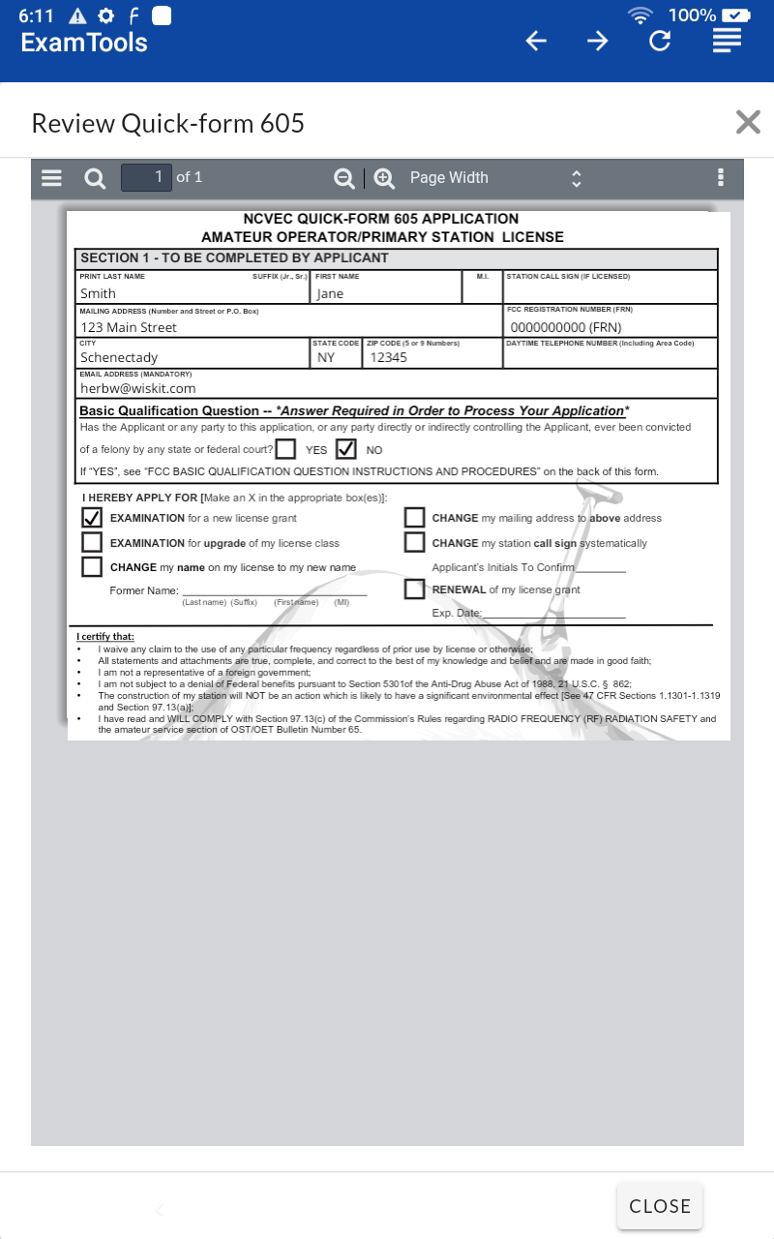
Review Quick Form 605
Note the six bullet points you are certifying when you sign.
If you notice any errors in the information on the form, please inform the Volunteer Examiner who is assisting you with the signing process.
Press the CLOSE button on the bottom right when done.

Slide 21
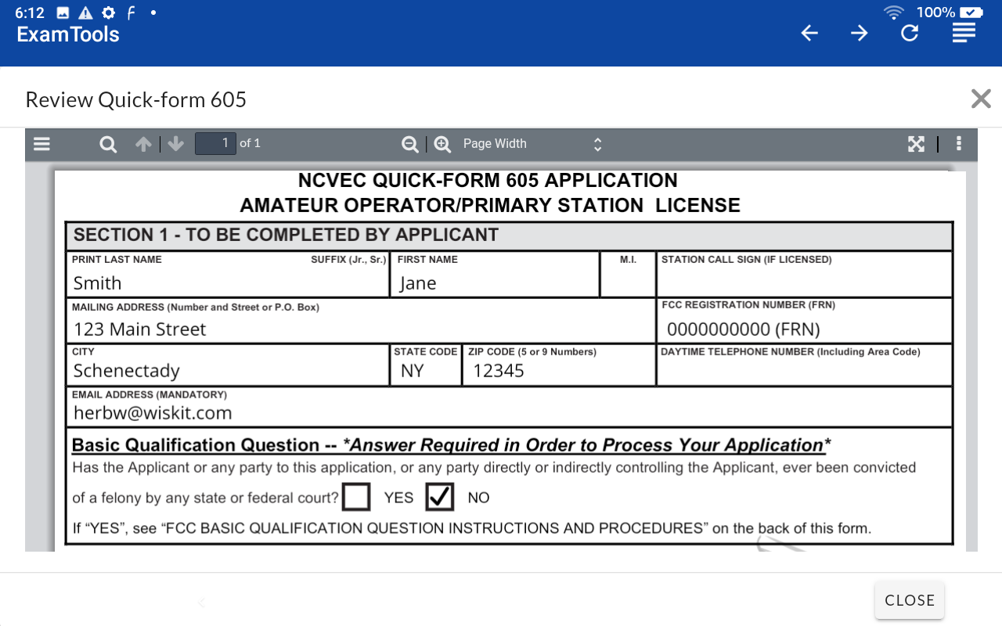
Review Quick Form 605
If you rotate the tablet, you get a larger view of the form.
Use your finger to scroll to the bottom.

Slide 22
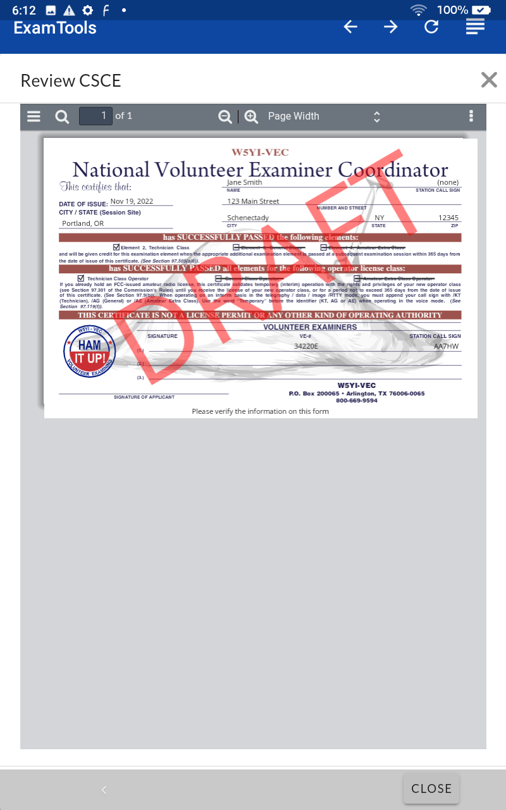
Review CSCE
If you notice any errors in the information on the form, please inform the Volunteer Examiner who is assisting you with the signing process.
Press the CLOSE button on the bottom right when done.
You will receive a signed copy of this form by email.

Slide 23
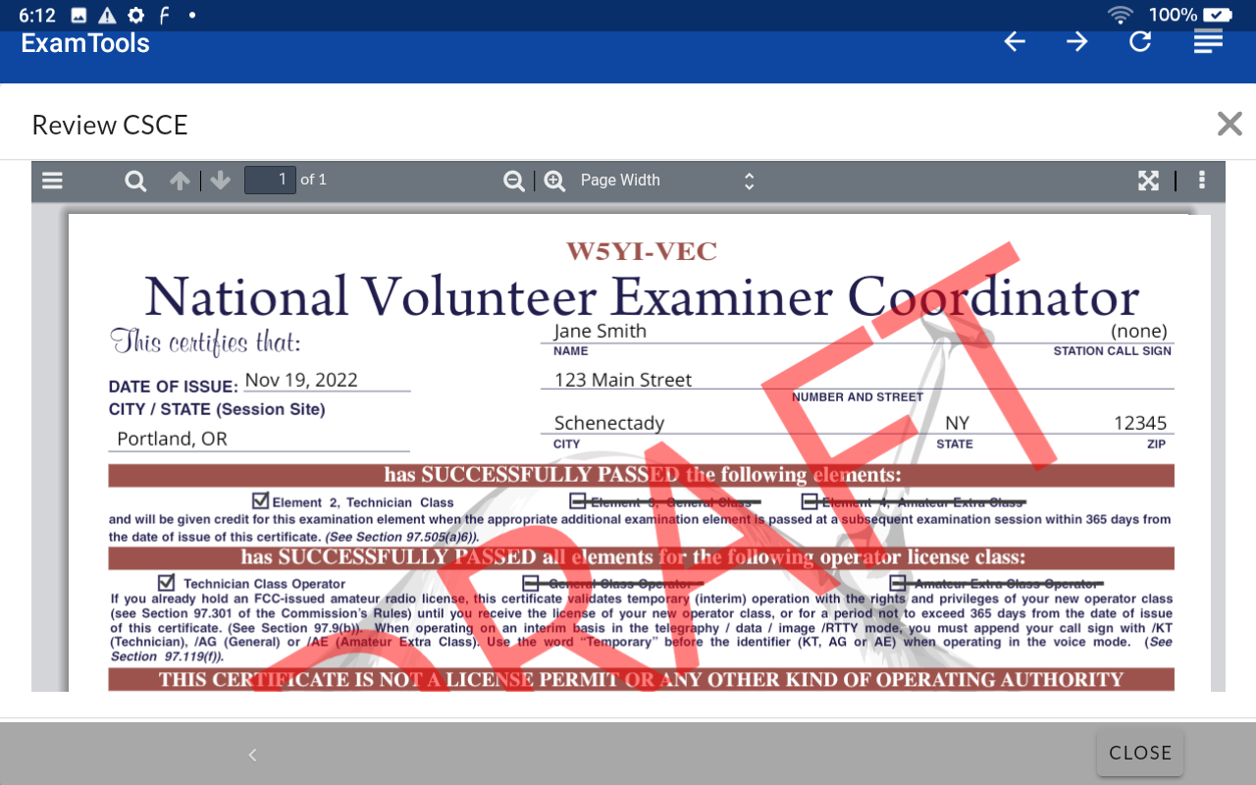
Review CSCE
If you rotate the tablet, you get a larger view of the form.
Use your finger to scroll to the bottom.

Slide 24
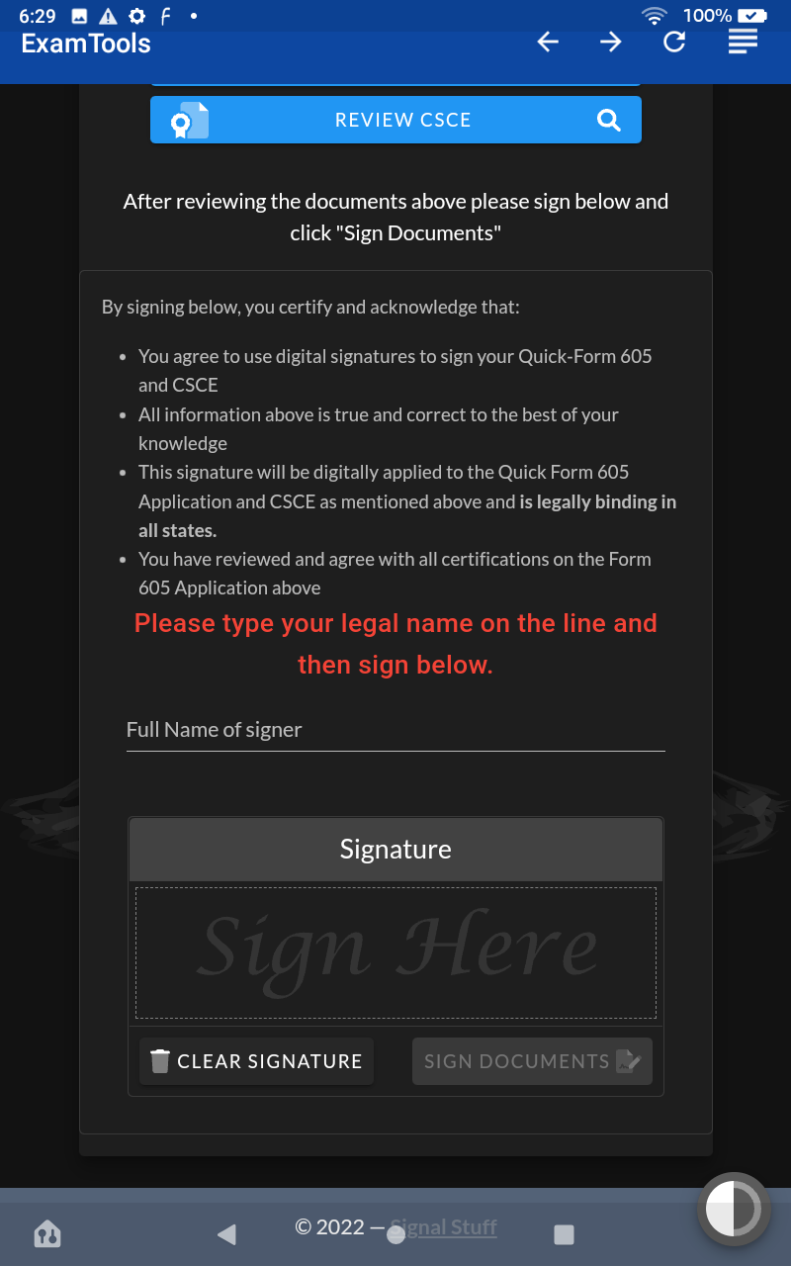
Ready to Sign
Type your name on the line below the red message.
Sign in the box.

Slide 25
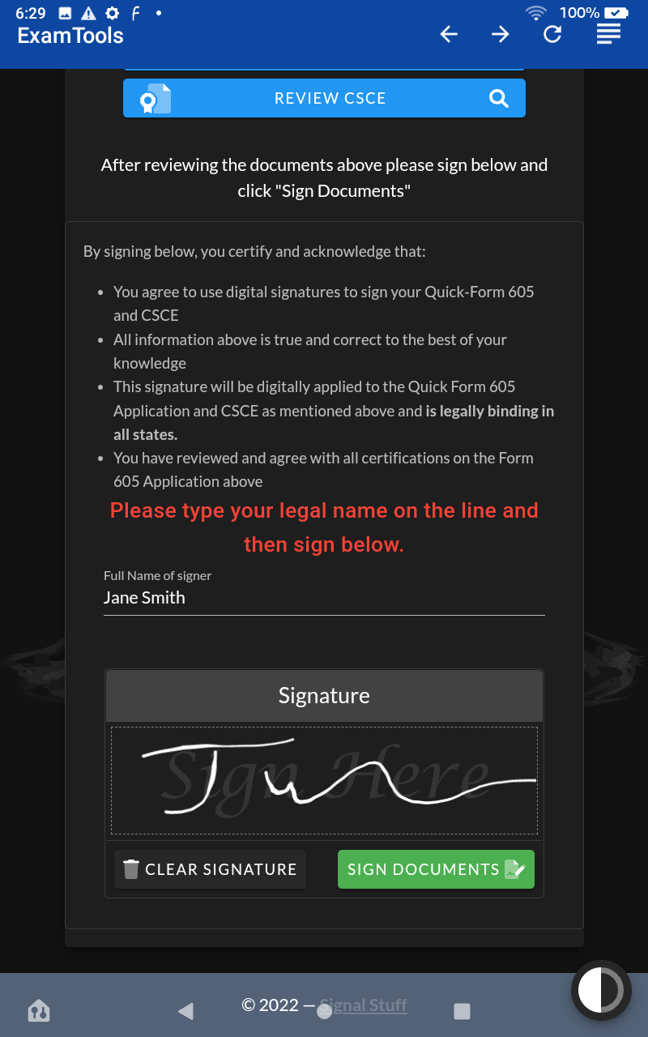
Ready to Sign
If you are not satisfied with your signature, click CLEAR SIGNATURE and try again.
When you are satisfied, click the green SIGN DOCUMENTS button.

Slide 26
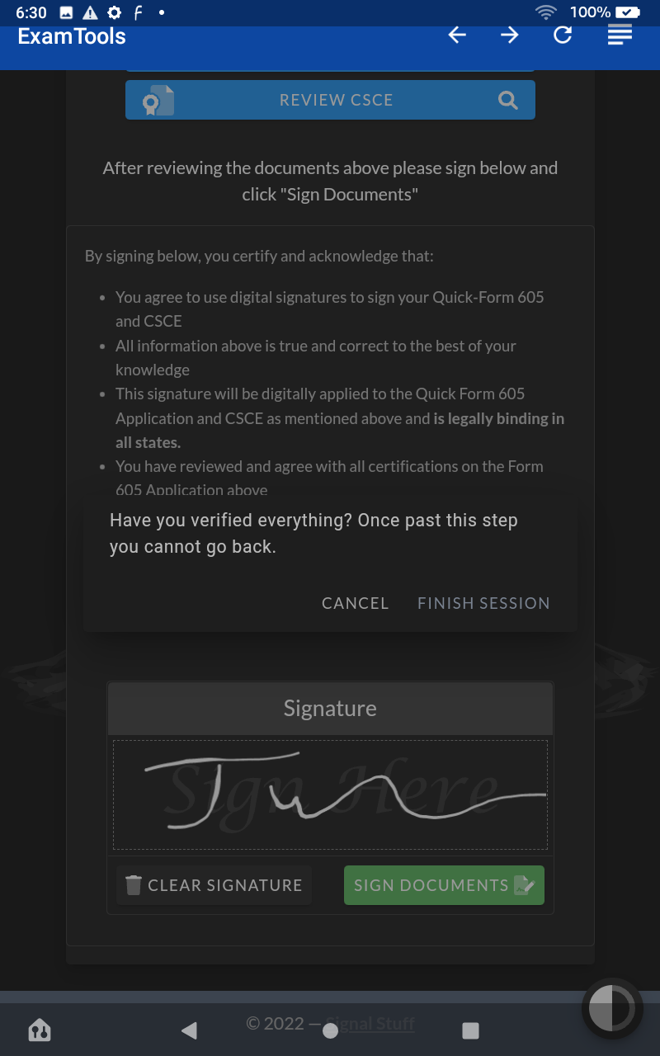
Finish Session
Click the FINISH SESSION button.

Slide 27
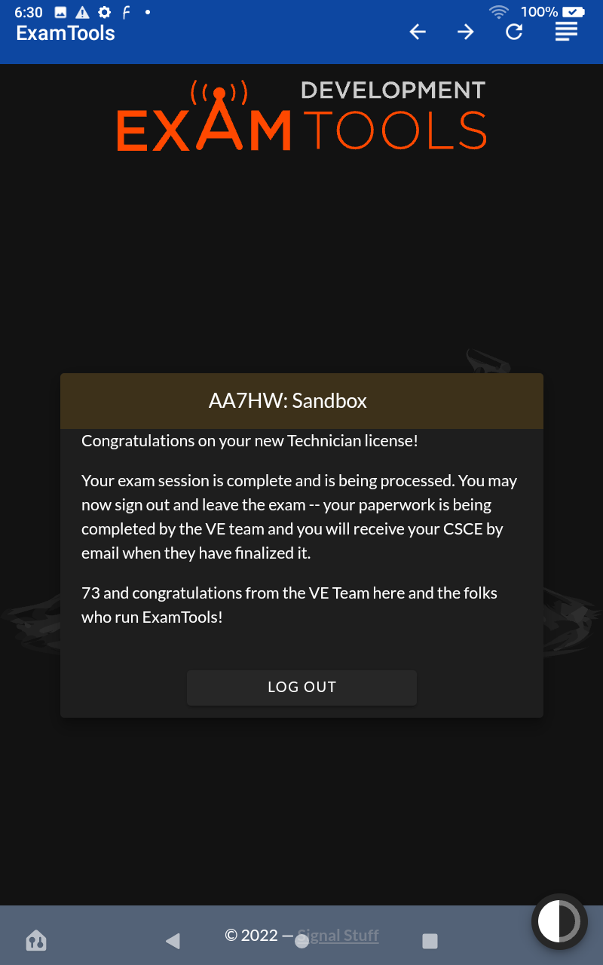
Congratulations!
Congratulations on your new license.
Please return the tablet to the VE who is assisting you.
If you earned an upgrade, you can use your new privileges as soon as you receive your CSCE by adding an /AG or /AE after your current call sign.

Slide 28
Next Steps
If you earned a new license, you should receive an email from the FCC the next business day, with instructions how to pay your $35.00 fee. Pay using a laptop or desktop computer, since the FCC can not handle payments made on tablets of smart phones.
You should receive an email with instructions on how to download your license in PDF format the next business day if no payment is due, or the day after you submit your payment.

Slide 29
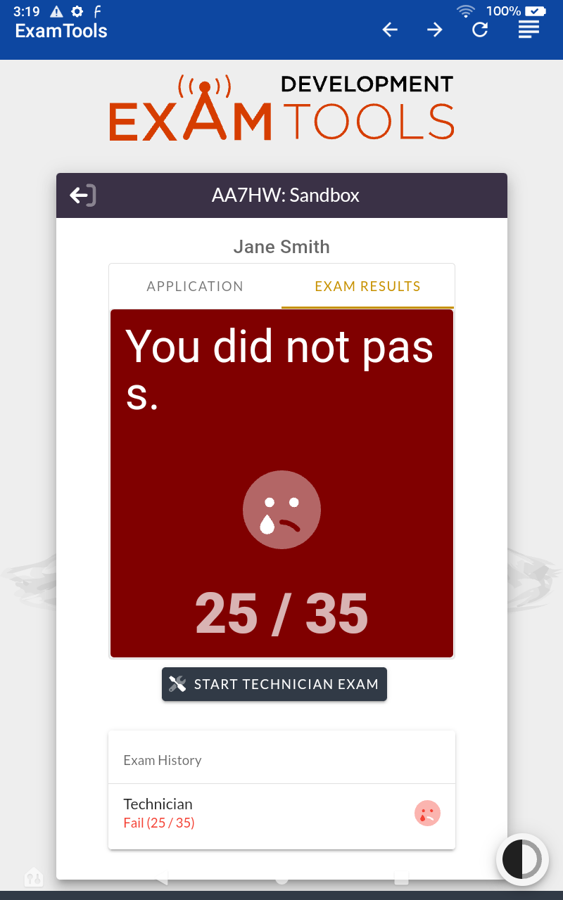
If You Did NOT Pass …
Please do not get discouraged.
We recommend Study Mode on hamstudy.org (register for a free account).
If you wish to make another attempt today, you will need to pay an additional $14.00 fee.
Otherwise, please return the tablet.

Slide 30
For more information:
Refer to the What’s Next … handout.
Refer to https://aa7hw.org for more information on earning or upgrading your license, including resources, studying, and online license exam sessions.
If you earned an Amateur Extra license, we invite you to join our team as a Volunteer Examiner. Please see the above website for more information.

